Slide 1



MOVIE RECOMMENDATION SYSTEM
The best movie recommendation systems turn endless scrolling into effortless discovery, matching your mood with the perfect film

Slide 2





Introduction
A movie recommendation system suggests films based on user preferences, such as genre, actors, and directors. It offers personalized recommendations, keeping content fresh for both new and returning users. First-time users can receive smart suggestions even with minimal input, ensuring an engaging experience for all.

Slide 3
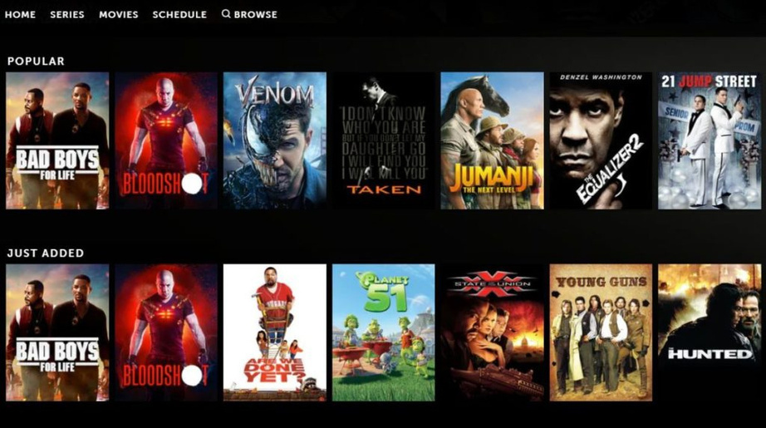
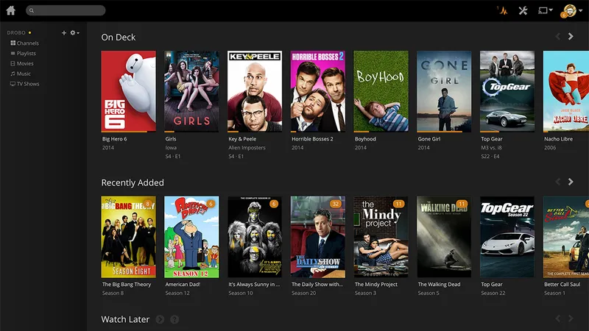
DOMAIN
Just as platforms like Instagram and Flipkart use advanced recommendation systems to suggest content or products based on user interactions, movie recommendation systems similarly monitor user activity to enhance the experience. Platforms like Netflix and Amazon Prime track what movies or TV shows a user has watched, their ratings, and even how long they watched a certain genre. This data is used to recommend similar movies, new releases in preferred genres, or films featuring favorite actors and directors. Over time, these systems learn more about the user’s preferences, becoming more accurate in predicting what they might enjoy.

Slide 4



PROBLEM STATEMENT
The project aims to develop a movie recommendation system that effectively predicts user preferences based on various factors such as genre, ratings, cast, and other movie metadata. While existing systems provide recommendations, they often face limitations in understanding nuanced user behavior and preferences across demographics, genres, and time periods. The challenge lies in improving recommendation accuracy by analyzing diverse data points and integrating machine learning techniques to enhance user experience.

Slide 5



GOAL
The goal of the project is to create a personalized movie recommendation system by analyzing user preferences through exploratory data analysis (EDA) and machine learning techniques. The system seeks to predict movie preferences by examining the relationships between various movie features and user behaviors. Ultimately, this will lead to more tailored recommendations, increased user satisfaction, and a deeper understanding of factors that influence movie preferences, while addressing dataset limitations and performance challenges.

Slide 6

DATASET: MOVIE.C
SOURCE Link: :
https://www.kaggle.com/code/osamaabidoo/imdb-tmdb-movies-recommender graph text
>The dataset used for this project was sourced from Kaggle
>The dataset used in this movie recommendation system consists of 1,048,576 entries and 31 columns.
>The columns include various metadata about the movies, such as title, vote average, vote count, release date, revenue, runtime, budget, and several others related to cast, crew, production details, and genres.

Slide 7
DATA FEATURES:
Nominal Data :
ID: A unique numeric identifier for each movie, useful for identifying individual movies and tracking relationships between movies and ratings.
Title: The name of the movie, used for identifying movies during analysis and comparing their popularity.
Overview: A summary of the movie’s narrative, which can be analyzed using text mining techniques to extract themes or keywords.
Tagline: A marketing phrase associated with the movie, providing insight into the film's marketing strategy and themes.
Production Companies and Countries: Companies that produced the film and the country where the film was produced, useful for analyzing the effect of production entities on a movie’s success.
Spoken Language: The languages spoken in the movie, where analyzing language distribution can provide insights into market trends and international reception.

Slide 8
Keywords: Tags that describe the main themes of the movie, useful in text analysis to help identify common themes or genres.
Stars: The main actors of the movie, where analyzing their performance can reveal trends in actor success and movie outcomes.
Writer, Producer, and Composer: Individuals responsible for writing, producing, and composing for the movie, helping explore the influence of these creative roles on the movie's success.
Genre List and Cast List: The genres and actors in the movie, useful for genre analysis and examining the influence of casting on ratings or revenue.
Categorical Data:
Certificate: The certification given to the movie (e.g., "UA", R-rated), useful for comparing movie success based on certification (e.g., family-friendly vs. adult content).
Release Year: The year the movie was released, important for time series analysis and spotting trends across years.

Slide 9
Ordinal Data :
Vote Average: The average rating a movie has received (usually on a 1-10 scale), which helps identify the highest or lowest-rated movies.
Vote Count: The total number of ratings a movie has received, indicating the popularity of a movie and helping analyze trends between ratings and vote counts.
Release Date: The date the movie was released, useful for time-series analysis and understanding trends over different time periods.
Revenue: The total earnings of the movie, useful for analyzing relationships between revenue, ratings, and budget.
Run Time: The duration of the movie (in minutes), which can be analyzed to see if longer or shorter movies perform better in terms of ratings or revenue.
Budget: The total production cost of the movie, helping compare movies in terms of financial investment versus revenue and success.
Popularity: A measure of how well the movie is received by audiences, which can be correlated with other variables like revenue, vote average, and vote count to identify popular trends.
IMDb Rating: The IMDb user rating, based on audience feedback, used to analyze the relationship between user ratings and other factors like revenue and budget.

Slide 10
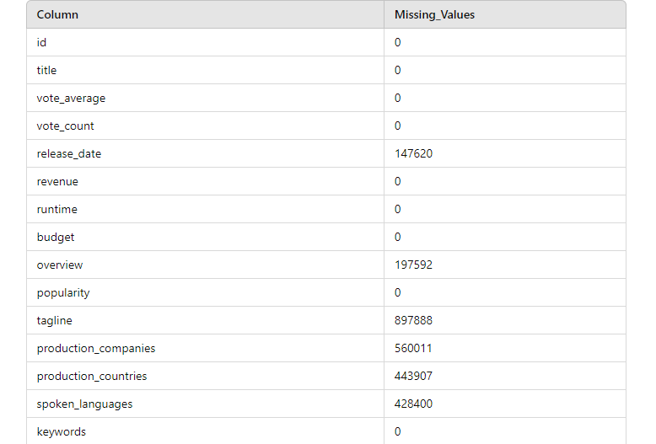
Missing Values :

Slide 11
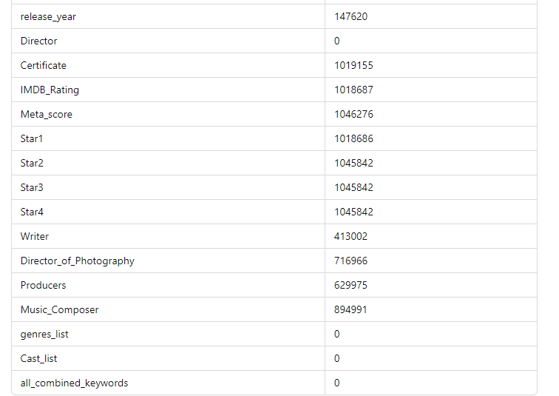

Slide 12
DATASET LIMITION
While the dataset provides a comprehensive view of the movie recommendation system, it has several limitations that need to be considered when conducting analyses and drawing.
1.Outliers:
According to our dataset, the budget column contains an outlier value of $100,000,000 for the movie "Avatar", which is significantly higher than the average budget of other movies in the dataset, it may be challenging to understand the context and significance of the outlier (e.g., why "Avatar" had a budget of $100,000,000).
2.Missing Values:
The cast_list column contains missing values for some movies, such as "The Shawshank Redemption”, “The Lord of the Rings”, "Titanic", so the missing values can increase error rates, as the data may not be able to accurately predict outcomes and also challenging to identify patterns and relationships in the data.
3.Limited time scope:
According to our dataset, the dataset may only include movies from a limited time period, which can affect the accuracy of analysis. For example, the dataset only includes movies from the 1990s to the 2010s, which may not be representative of the entire history of cinema.
4.Correlated variables:
Correlation between budget and revenue: In our dataset, there is a strong correlation between the budget and revenue of movies in the dataset. This correlation can affect the accuracy of analysis, such as calculating the return on investment (ROI) of movies.
5.Skewed distributions:
In our dataset, the distribution of genres in the dataset is skewed, with most movies being classified as "Drama" or "Comedy". This can affect the accuracy of analysis, such as calculating the proportion of movies in each genre.
6. Lack of data clustering:
In our dataset, the dataset does not have any clustering of movies by genre, which can make it difficult to identify patterns and trends in the data.

Slide 13

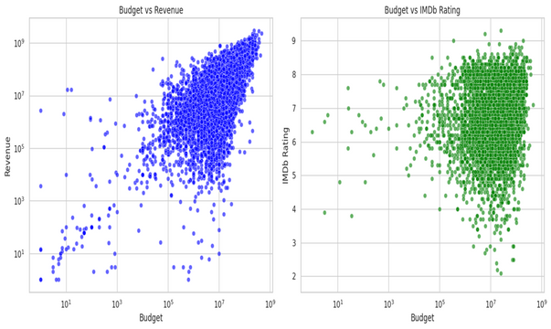
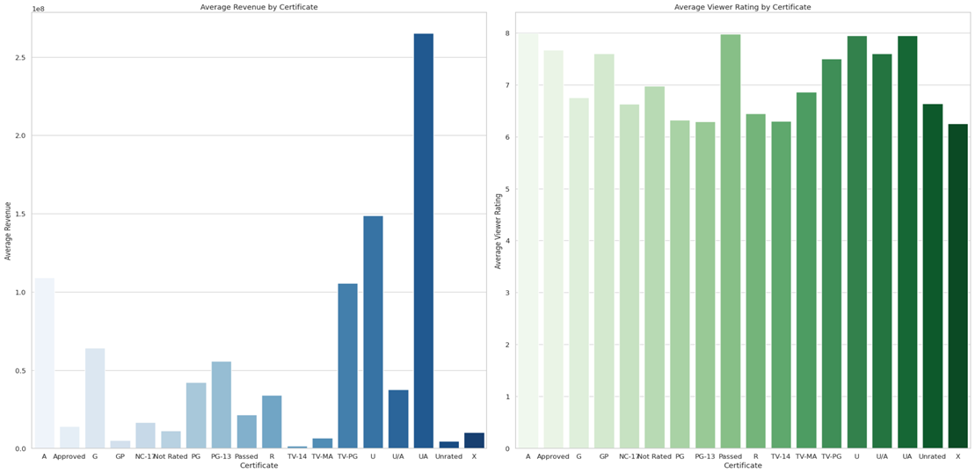
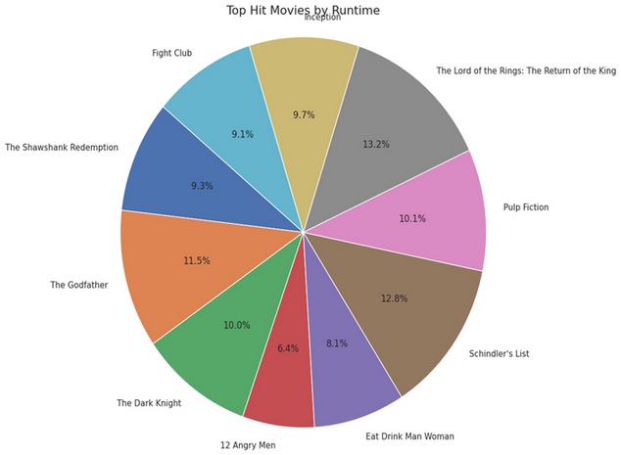
Data Visualization
& Insights.

Slide 14
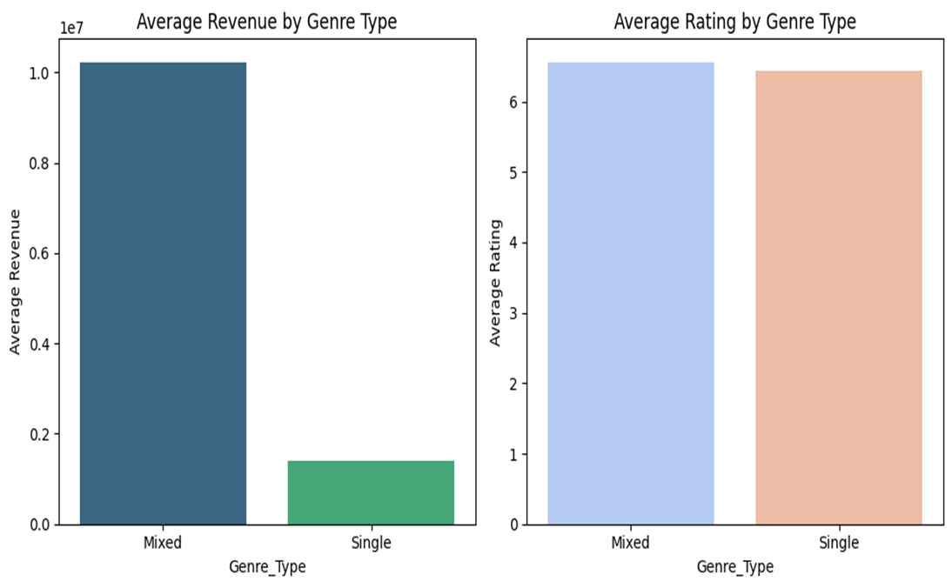
Q1. How does the distribution of genres impact a movie's success?

Slide 15
Insight:
● The graph shows that mixed-genre movies have higher average revenue than single-genre movies, but single-genre movies have a higher average rating. This suggests that mixed-genre movies may be more commercially successful, but single-genre movies are more critically acclaimed.
● It could be that mixed-genre movies appeal to a wider audience, while single-genre movies are more likely to appeal to niche audiences who are passionate about that particular genre.
This suggests that mixing genres could be a good strategy for increasing a movie's potential revenue without sacrificing audience approval.
Overall Insight:
● By targeting multiple genres can broaden a film's appeal and potentially lead to greater financial success.
● The data indicates that producing movies with elements from various genres might be a strategy for maximizing revenue. However, focusing on a single genre doesn't necessarily hinder a film's potential for positive audience ratings.

Slide 16
Q2.How does the movie certification (like PG, R, etc.) affect the average revenue and viewer ratings?

Slide 17
Insight:
1. Average Revenue by Certificate (Left Graph):
● UA (Unrestricted Adults) has the highest average revenue, followed by U (Unrestricted).
● Certificates like G (General Audience), PG (Parental Guidance), and R (Restricted) have significantly lower average revenues.
2. Average Viewer Rating by Certificate (Right Graph):
● TV-MA (Mature Audiences) and R rated movies have the highest viewer ratings, indicating that movies targeted at more mature audiences tend to receive better reviews from viewers.
● Unrated, G, and PG-13 movies generally have lower average ratings, indicating that while they might be family-friendly, they do not receive as high of viewer ratings.
● This suggests a potential trade-off: while some certificates might cater to more general audiences (and bring in more revenue), they may not always receive the highest ratings.
Overall Insight:
Movies with broader certificates (like UA or U) might make more money, but those targeting mature audiences (like R or TV-MA) may receive better ratings. Studios may focus on a balance depending on their goals: revenue or critical acclaim.

Slide 18
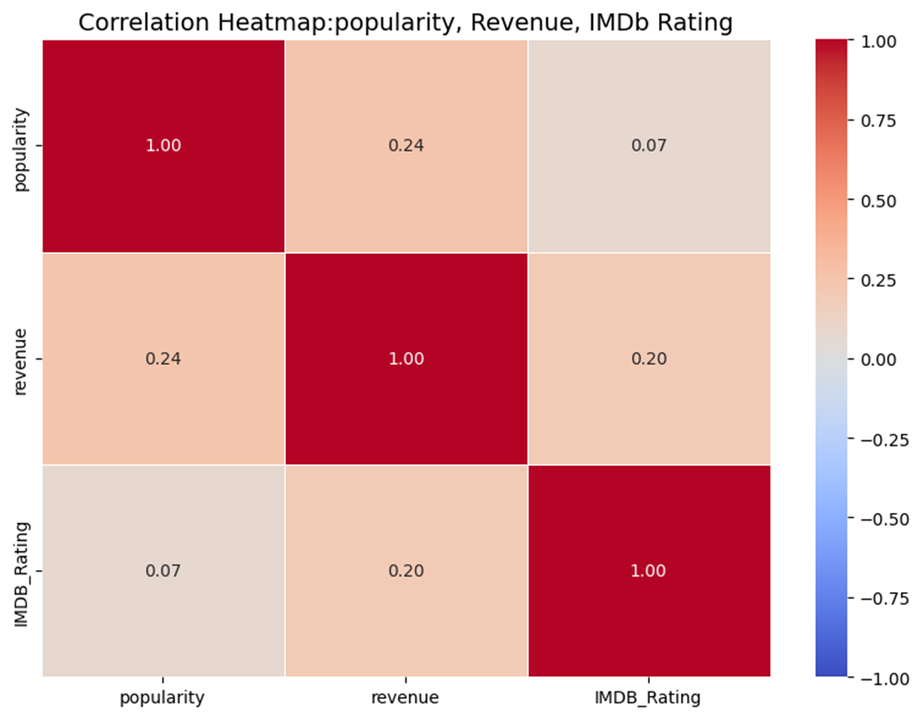
Q3.What is the correlation between a movie's popularity, revenue, and IMDb rating?

Slide 19
Insight:
1. Popularity vs. Revenue (Top Left of Heatmap):
There is a weak positive correlation of 0.24 between popularity and revenue, suggesting that while more popular movies may generate higher revenue, this relationship is not very strong. Other factors likely contribute more significantly to box office success.
2. Revenue vs. IMDb Rating (Bottom Left of Heatmap):
The correlation of 0.20 between revenue and IMDb rating indicates that movies with higher revenues do not necessarily have higher IMDb ratings. This reflects that critical acclaim or viewer satisfaction (IMDb rating) is not always aligned with box office performance.
3. Popularity vs. IMDb Rating (Bottom Right of Heatmap):
With a very weak correlation of 0.07, there is almost no relationship between popularity and IMDb rating. This suggests that popular movies do not necessarily receive better ratings from viewers.
Overall Insight:
Popular movies might earn more revenue, but this doesn’t guarantee high IMDb ratings or critical acclaim. While higher-grossing movies show a small positive correlation with popularity and ratings, the connections are weak. This suggests that movie studios should consider multiple factors when aiming for either financial success or audience satisfaction. Balancing the two may be challenging, as popular and high-revenue films don't always score well with viewers.

Slide 20
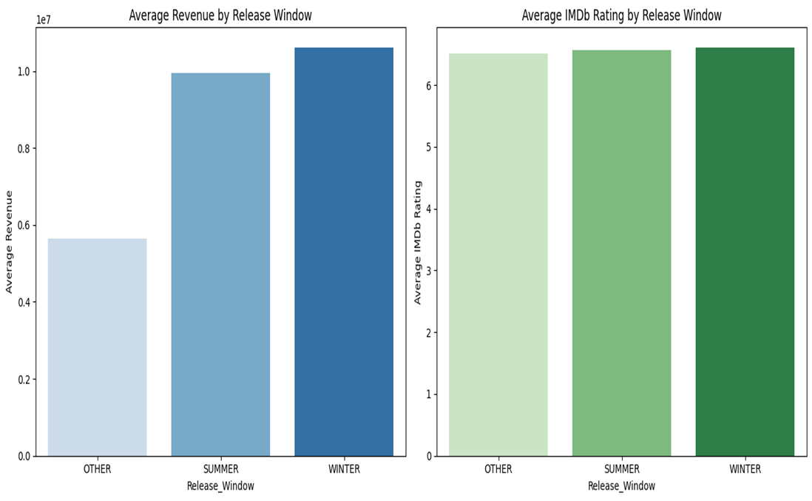
Q4. How do movie release windows (summer, winter, or other periods) affect average revenue and IMDb ratings?

Slide 21
Insight:
1. Average Revenue by Release Window (Left Graph):
● Winter releases have the highest average revenue, followed closely by Summer releases, while Other release windows generate the least average revenue.
● This makes sense because the Winter period includes the holiday season, which is traditionally a time for blockbuster movie releases when audiences are more likely to go to theaters.
2. Average IMDb Rating by Release Window (Right Graph):
● The IMDb ratings are relatively consistent across all three release windows (Winter, Summer, Other), hovering around a rating of 6.5 to 7.
● This suggests that the time of year a movie is released doesn't significantly impact audience perception or satisfaction. Even though some seasons generate more revenue, audience enjoyment (measured by IMDb rating) stays fairly constant.
Overall Insight:
IMDb Ratings Stay Constant: Despite the difference in revenue, movies released in different windows receive similar ratings. This indicates that higher revenue is more likely tied to the time of release rather than the quality or audience satisfaction.

Slide 22
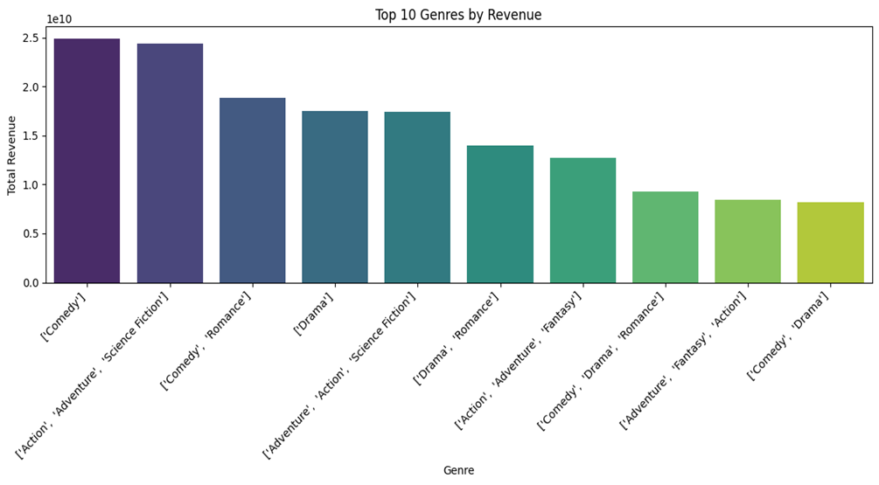
Q5. Which movie genres generate the highest total revenue?

Slide 23
Insights:
The graphs illustrate a comparison of average revenue and average rating for movies categorized into two genre types: "Mixed" and "Single."
Revenue Insights:
● Mixed genre movies significantly outperform single genre movies in terms of average revenue. This suggests that films appealing to a broader audience through multiple genres tend to be more commercially successful.
Rating Insights:
● The average rating for both mixed and single genre movies is relatively similar.
● Single genre movies have a slightly higher average rating than mixed genre movies, although the difference doesn't appear to be substantial.
Overall Insight:
Mixed genre movies: Higher average revenue, suggesting wider commercial appeal but potentially with slightly diluted critical acclaim or audience preference.
● Single genre movies: Maintain a comparable or slightly higher average rating, suggesting stronger genre appeal but potentially at the cost of a narrower audience and lower revenue.

Slide 24
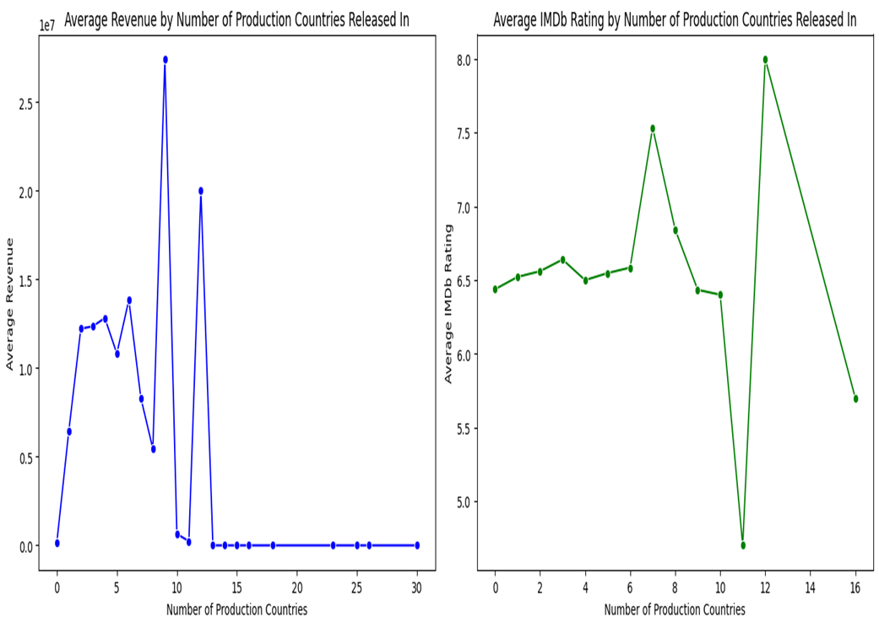
Q6. How does the number of production countries affect a movie's revenue and IMDb rating?

Slide 25
Insights:
1. Average Revenue by Number of Production Countries (Left Graph):
● The graph shows a spike in revenue when movies are released in around 9-10 countries, with revenue reaching its peak. However, there’s also a significant drop after this peak.
● Beyond 10 countries, the revenue drops to nearly zero, indicating that releasing movies in more countries does not necessarily translate to higher revenue. In fact, there might be diminishing returns after a certain point.
2. Average IMDb Rating by Number of Production Countries (Right Graph):
● IMDb ratings seem relatively consistent between 6.5 and 7 for movies released in up to 10 countries.
● Interestingly, there is a sharp dip in IMDb rating for movies released in exactly 10 countries, followed by a sharp increase in 12 countries. This indicates that audience reception fluctuates and may not correlate directly with the number of countries a movie is released in.
Overall Insight:
There seems to be a sweet spot for revenue around 9-10 production countries. Releasing in too many countries might dilute the movie’s appeal, leading to lower returns.
The number of countries a movie is released in doesn’t show a strong correlation with IMDb ratings, with significant fluctuations rather than a steady increase or decrease. This implies that releasing in more countries does not consistently enhance audience satisfaction.

Slide 26

Q7. How does a movie's budget relate to its revenue and IMDb rating?

Slide 27
Insight:
1. Left Side (Budget vs. Revenue):
● Positive Correlation: There's a clear positive correlation between budget and revenue. This means that movies with higher budgets tend to generate higher revenues.
● Wide Spread: While there's a general trend, there's a significant spread in revenue, especially for movies with mid-range to high budgets. This suggests that other factors besides budget influence a movie's financial success (e.g., marketing, genre, critical reception).
2.Right Side (Budget vs. IMDb Rating):
● No Clear Correlation: There isn't a strong linear correlation between budget and IMDb rating. This implies that spending more money on a movie doesn't necessarily guarantee a higher rating from viewers.
● Concentration Around 6-7: A large proportion of movies, regardless of budget, cluster around the 6-7 IMDb rating range. This suggests that most movies fall within an "average" range of perceived quality.
● Outliers: There are a few outliers with high budgets and lower ratings, indicating that some expensive movies didn't resonate well with audiences.
Overall Insight:
● Budget Matters, But Not Entirely: Budget plays a role in a movie's revenue potential, but it's not the only factor.
● Quality vs. Spending: A larger budget doesn't directly translate to a higher-rated or more critically acclaimed film. Other factors heavily influence audience and critic perception.

Slide 28
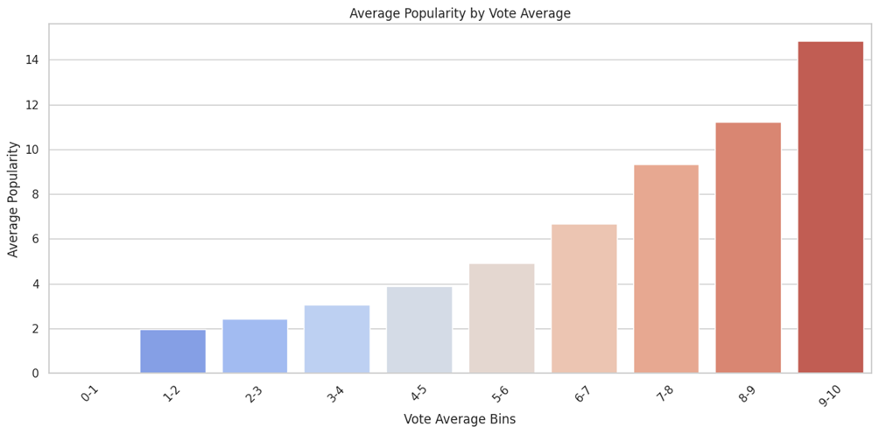
Q8.How does the popularity of movies vary with their vote average ?

Slide 29
Insights:
1.Low to Moderate Vote Averages (0-5):
● Movies with lower vote averages (0-5) have consistently lower average popularity, with no significant rise until the 5-6 range.
● This indicates that movies receiving average to poor ratings tend to have a much lower popularity, possibly due to weaker audience reception or negative word-of-mouth.
2.Moderate to High Vote Averages (5-8):
● As movies reach higher vote averages (5-8), there is a noticeable jump in popularity.
● Movies in this range start to gain more traction, reflecting that audiences are more likely to engage with movies that have received stronger, more favorable reviews.
3.High to Very High Vote Averages (8-10):
● Movies in the 8-10 vote average range show a steep rise in average popularity, peaking for those with a 9-10 vote average.
● This suggests that critically acclaimed and highly rated movies are far more popular, with an exponential increase in audience engagement, likely driven by excellent reviews and high recommendations.
Overall Insight:
Strong Correlation Between Vote Average and Popularity: The chart clearly shows that movies with higher vote averages tend to be significantly more popular. The higher the rating a movie receives, the more popular it becomes with audiences.
Popularity Spikes for Top-Rated Films: The most notable surge occurs for movies with a 9-10 vote average, indicating that audiences are heavily drawn to highly acclaimed movies, both in terms of reviews and likely overall quality.

Slide 30
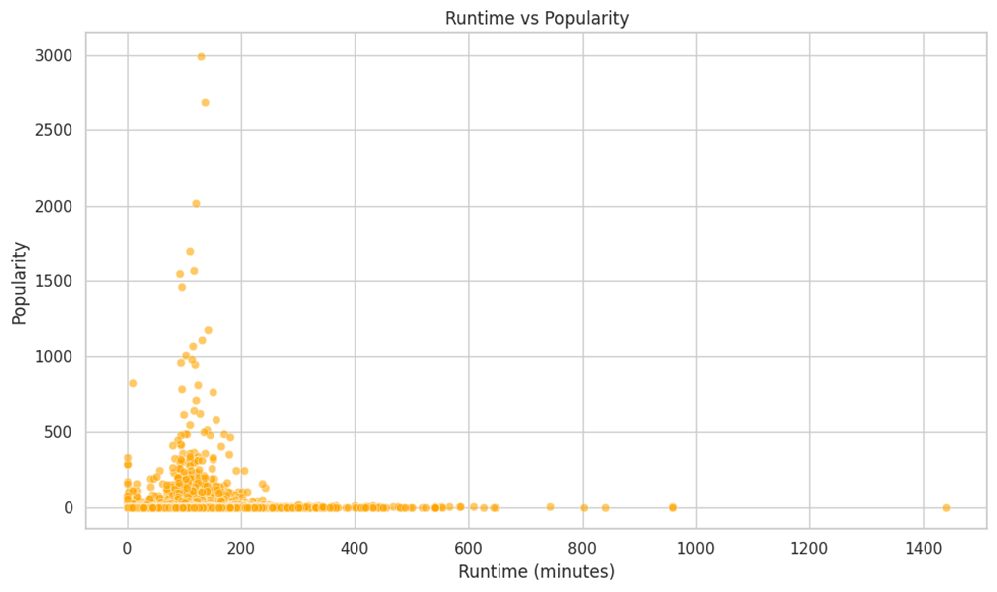
Q9.How does a movie's runtime affect its popularity and revenue?
The data points are clustered in a specific region of the graph, with a high density of points around the lower runtime and higher popularity values. This indicates that a significant number of movies have relatively short runtimes and achieve high popularity.

Slide 31
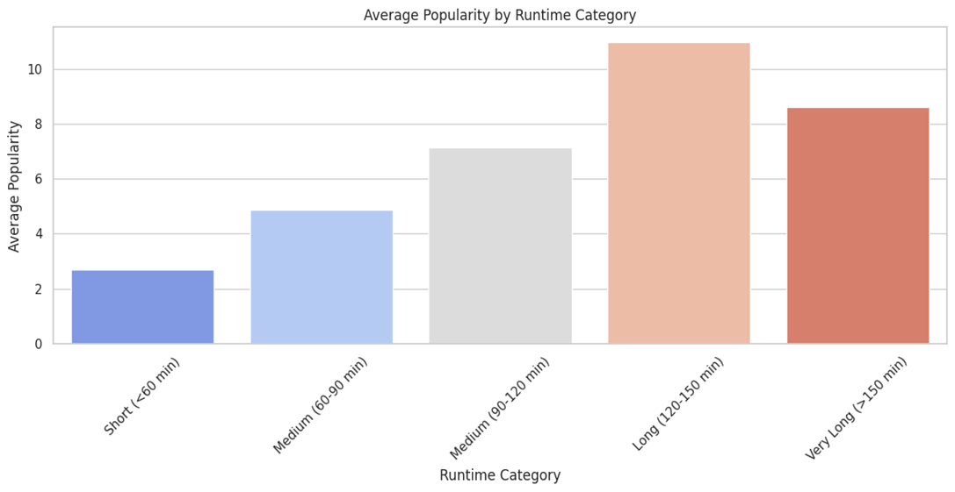
Overall, there seems to be a general trend of decreasing popularity as runtime increases. This could suggest that viewers have a preference for movies that are not too long.

Slide 32
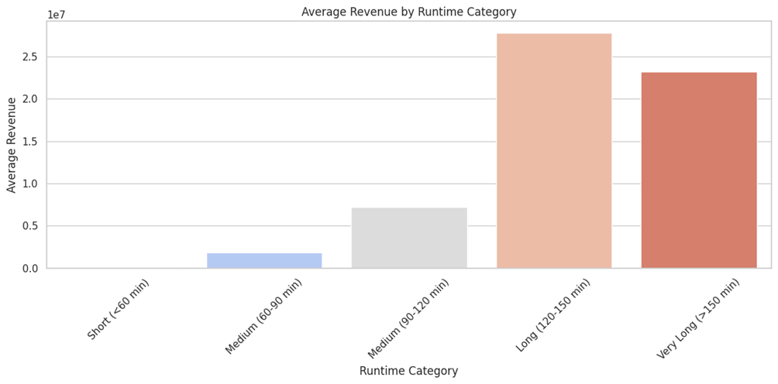
Overall, there seems to be a general trend of increasing revenue as runtime increases. This could suggest that viewers are willing to pay more for longer movies, potentially due to the higher production costs associated with them.

Slide 33
Overall Insight:
The relationship between runtime, popularity, and revenue may vary across different genres. For example, certain genres like dramas or epics may have higher acceptance for longer runtimes.
The quality of the movie, including its storytelling, acting, and production values, will also influence its popularity and revenue.The specific preferences of the target audience should be considered when making decisions about runtime.

Slide 34
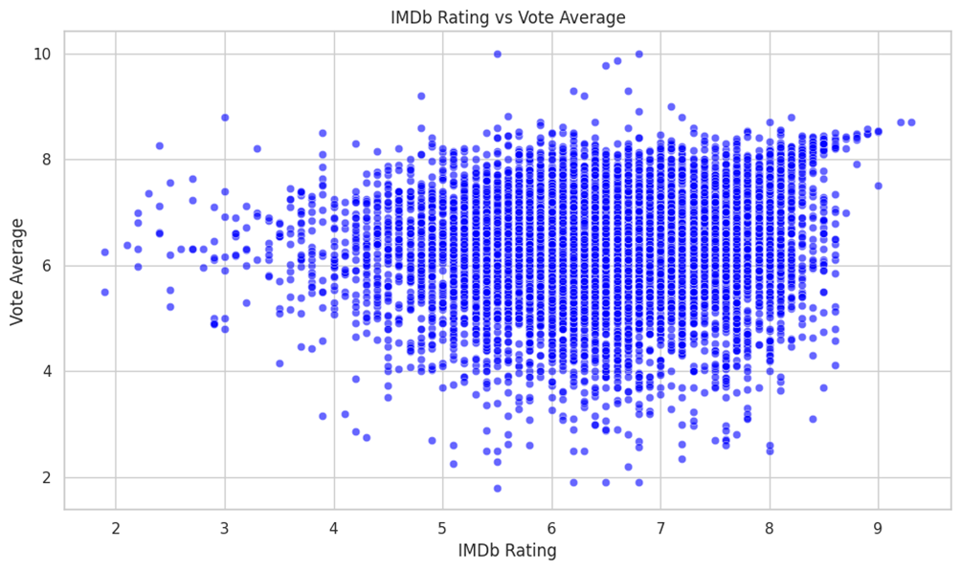
Q10.How does the IMDb rating relate to the vote average and the Meta score of movies?

Slide 35
Insights:
1.Strong Clustering in the Mid-Range:
● The majority of movies are concentrated in the IMDb rating range of 5-8 and vote average range of 6-8. This suggests that most movies fall into a mid-range of both IMDb ratings and vote averages.
● This could indicate that these movies generally receive moderate approval from both critics and audiences, as neither metric skews too far toward the extremes.
2.Low IMDb Ratings, Varied Vote Averages:
● Movies with lower IMDb ratings (2-5) show a wider range of vote averages, with some having relatively high vote averages (up to 8). This indicates that even movies with poor critical reception can sometimes receive favorable audience votes, suggesting a divergence between critics and viewer opinions for certain films.
3.High IMDb Ratings Correlate with Higher Vote Averages:
● As IMDb ratings increase toward 8 and 9, the vote averages also tend to remain high, clustering around 7-9. This implies that movies with higher IMDb ratings generally align with higher vote averages, reflecting consensus between critics and audiences for these top-rated films.
Overall Insight:
Moderate Correlation: The scatter plot reveals a moderate correlation between IMDb ratings and vote averages, particularly in the mid to high rating ranges. While some divergence exists for lower-rated movies, there is a clear alignment of high IMDb ratings with higher vote averages, showing that movies highly rated by IMDb are generally well-received by the audience as well.

Slide 36
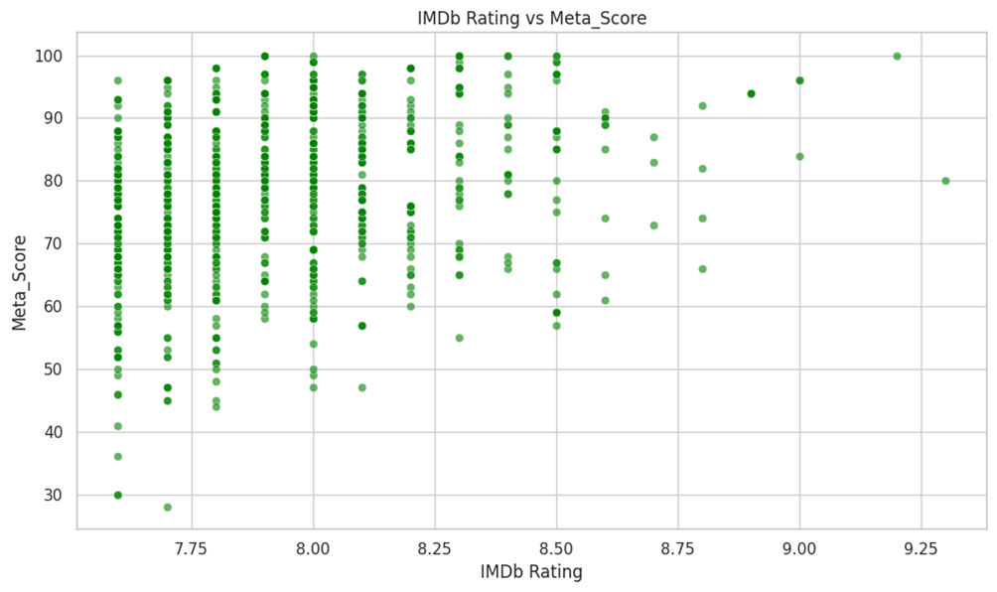

Slide 37
Insights:
1.Strong Clustering in the Middle:
● Most movies are clustered around IMDb ratings between 7.5 and 8.0 and Meta Scores between 60 and 90. This suggests that a significant number of movies receive moderately high ratings from both audiences and critics.
2.Higher Meta Scores Show Similar IMDb Ratings:
● Movies with Meta Scores above 90 tend to have IMDb ratings in the range of 7.5 to 9.0. This indicates a stronger alignment between critics and audience reception for highly rated films.
3.Wide Spread in Meta Scores for Mid-Level IMDb Ratings:
● For IMDb ratings around 7.5 to 8.0, there's a wide range of Meta Scores (from 30 to 100). This suggests that some movies with moderate audience approval receive varied critical reception, indicating divergence between critic and audience opinions.
Overall Insight:
Moderate to Strong Correlation: The plot reveals a moderate to strong correlation between IMDb ratings and Meta Scores, especially for movies with higher scores. Movies with higher IMDb ratings (above 8.0) are generally well-received by critics too, reflected in their higher Meta Scores.
Divergence at Mid-Range: The mid-range IMDb ratings (7.5-8.0) show a broader distribution of Meta Scores, suggesting some divergence between critic and audience opinions for films in this categories.

Slide 38
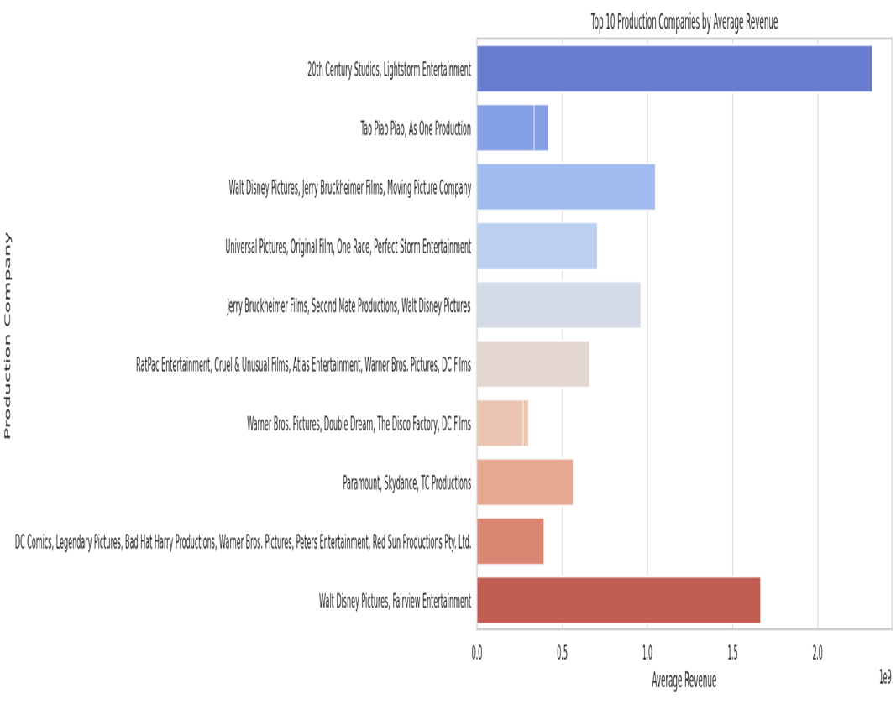
Q11.Which production companies have the highest average budgets and revenues?

Slide 39
Insight:
This graph shows the top 10 production companies in terms of average revenue. 20th Century Studios, Lightstorm Entertainment tops the list with the highest average revenue, followed by Walt Disney Pictures, Fairview Entertainment and DC Comics, Legendary Pictures, Bad Hat Harry Productions, Warner Bros. Pictures, Peters Entertainment, Red Sun Productions Pty. Ltd. The average revenue for most companies are less than $1 billion while 20th Century Studios, Lightstorm Entertainment has an average revenue exceeding $2 billion. This graph provides a good overview of the top-performing production companies in the industry.
Overall Insight:
It is interesting to note that many of the companies that have high average revenue are associated with big-budget films and franchises. This suggests that there is a strong correlation between average revenue and the scale of a film production.

Slide 40
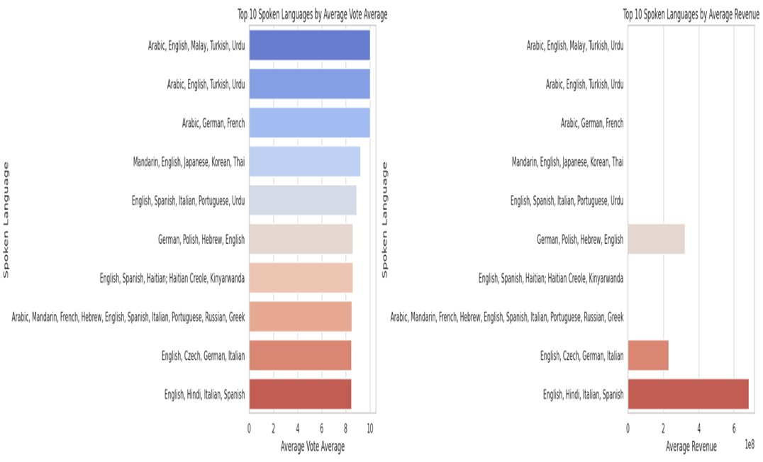
Q12.What is the impact of spoken language on movie performance in terms of average ratings and revenue?

Slide 41
Insights:
1.Top 10 Spoken Languages by Average Vote Average:
● The chart ranks languages based on their average vote scores.
● Arabic, English, Malay, Turkish, and Urdu dominate the top of the chart with an average vote score close to 8.
● This indicates that movies in these languages tend to be highly rated by viewers, suggesting strong audience approval.
2.Top 10 Spoken Languages by Average Revenue:
● On the revenue side, English dominates the chart, particularly in combinations with Hindi, Italian, and Spanish, reaching an average revenue close to 6 x 10^8.
● Movies with German, Polish, and Hebrew as spoken languages generate moderate revenue, indicating a market niche.
● The inclusion of languages such as Arabic, German, French, while high in average vote averages, do not perform as well in terms of box office revenue, showing a disconnect between audience ratings and financial success.
Overall Insights:
● Strong Viewer Approval vs. Revenue: While some languages such as Arabic, English, and Urdu show strong audience approval, the connection between high vote averages and revenue isn't as direct. English-dominant movies, especially when paired with major international languages like Hindi and Spanish, perform the best in terms of revenue.

Slide 42
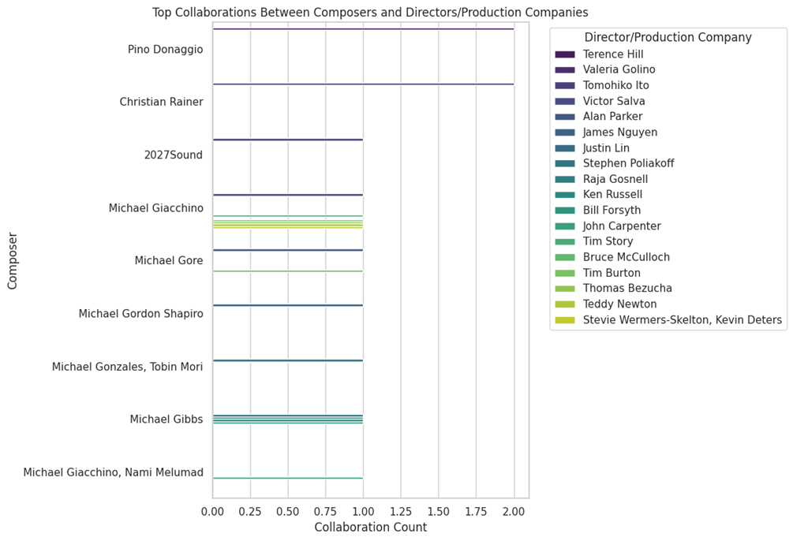
Q13.What are the most frequent collaborations between music composers and directors/production companies in the dataset?

Slide 43
INSIGHT:
● The bars for Pino Donaggio and Michael Giacchino are the longest, indicating that they have collaborated with the most directors/production companies.
● Many composers have collaborated with multiple directors/production companies, suggesting that there are strong working relationships and recurring partnerships in the film industry.
● There are also composers with shorter bars, indicating that they have collaborated with fewer directors/production companies. This could be due to various factors, such as their career stage, specialization, or personal preferences.
overall insight:
The horizontal bar chart provides a clear and effective way to visualize the collaboration frequencies between composers and directors/production companies. It helps us identify the most prolific collaborators, understand the dynamics of the film industry, and gain insights into the preferences of directors/production companies.

Slide 44

Q14. What are the runtimes of the top 10 hit movies based on IMDb ratings?

Slide 45
Insights:
1. Dominating Runtime – "The Lord of the Rings: The Return of the King":
● The largest section of the chart (13.2%) is attributed to The Lord of the Rings: The Return of the King. Given its extended runtime, it takes up a significant portion of the overall distribution.
2. Balanced Distribution Across Other Hits:
● Films like Schindler's List (12.8%), The Godfather (11.5%), and Pulp Fiction (10.1%) follow closely behind, indicating that several critically acclaimed films have longer-than-average runtimes.
3. Smaller Runtimes – "12 Angry Men" and "Eat Drink Man Woman":
● On the shorter end of the spectrum, 12 Angry Men occupies only 6.4% of the total, reflecting its relatively concise runtime compared to the other blockbusters.
4. Moderate Runtimes:
● Popular films such as Fight Club (9.7%), The Shawshank Redemption (9.3%), and The Dark Knight (10%) all have moderate runtimes, suggesting that even though they are feature-length films, they don't extend as long as epics like The Lord of the Rings.
5. Runtime Trends:
● This visualization suggests a trend where longer movies tend to be more epic in scope or belong to certain genres (e.g., historical dramas, fantasy). Meanwhile, shorter or average-length movies still gain popularity, often from thrillers or dramas that pack intense storytelling within a shorter time frame.
Overall Insight:
The pie chart demonstrates that hit movies span a wide range of runtimes, with epics like The Lord of the Rings and Schindler's List taking up a larger share, while shorter films like 12 Angry Men still retain a significant place in cinematic history despite their brevity.

Slide 46

Conclusion

Slide 47

The movie recommendation system created in this project offers personalized suggestions, solving challenges like limited genre options and the cold-start problem. The analysis shows that mixed-genre films often earn more revenue, although viewer ratings are stable across genres. Other important factors include movie budgets, release timing, actor fame, and age ratings, all impacting both financial success and audience approval. By considering these elements, the system can improve user satisfaction, making it a useful tool in the competitive streaming market and boosting user engagement.

Slide 48

Thank You
For Your Attention

